Slide 1
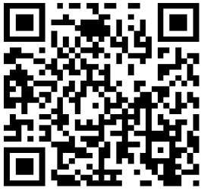
Access to TLQ
Login to
https://onlinesurvey.cityu.edu.hk/
Course Site on Canvas
Invitation email
“Teaching and Learning Questionnaire (TLQ) – Your response matters”
Scan QR code

